Slide 1
Pizza Sales Dashboard
File created on: 3/28/2025 6:50:06 AM

Slide 2
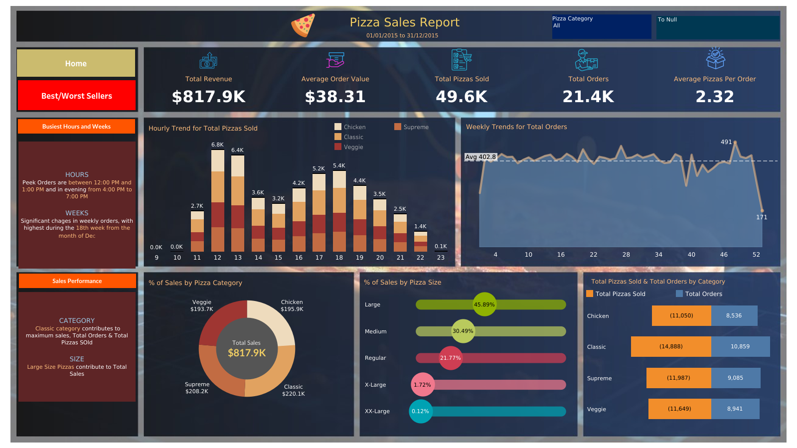

Slide 3
